Slide 1


END-TO-END SECURE MESSAGING Vitaly Shmatikov

Slide 2




Communications Today
Who can listen to your calls and chats?
Encryption? Yes.
Where is encryption applied?
Who has the keys?

Slide 3
Lawful Intercept in the U.S.
CALEA: Communications Assistance for Law Enforcement Act (1995)
FISA: Foreign Intelligence Surveillance Act (1978)
Separates domestic vs. foreign intelligence gathering
Foreign Intelligence Surveillance Court (FISC) provides warrant oversight – efficacy sometimes criticized
Also applies to data hosted by services (Gmail, …)
Most (almost all?) national governments mandate some kind of lawful intercept capabilities

Slide 4
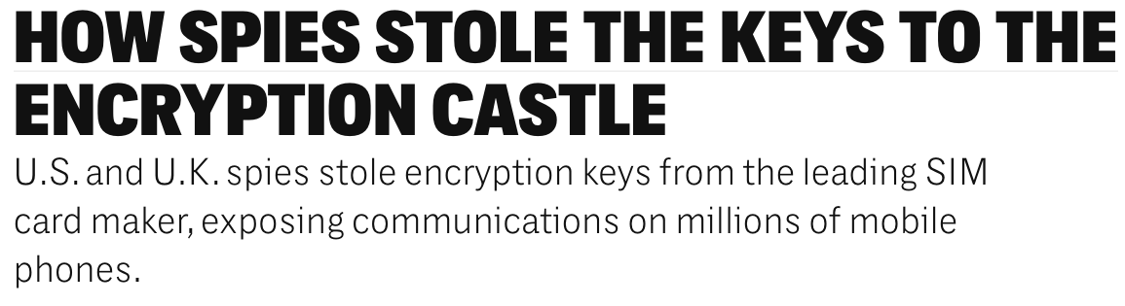
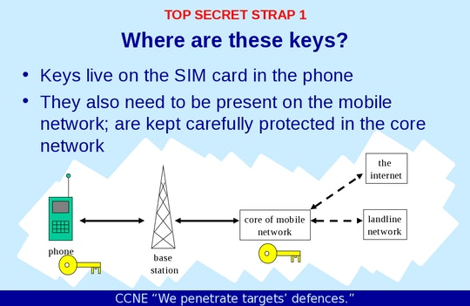
NSA and GCHQ hacked a major SIM manufacturer, stole the keys for millions of SIMs before they were shipped to wireless carriers worldwide
https://theintercept.com/2015/02/19/great-sim-heist/

Slide 5
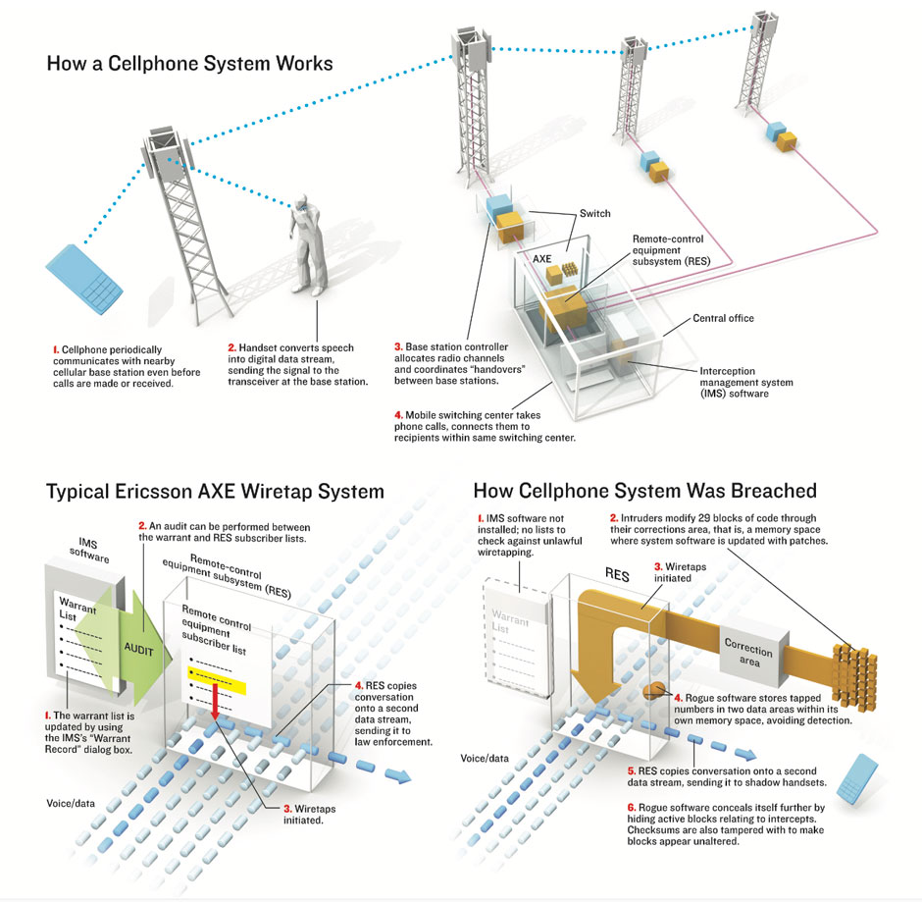

“The Athens Affair”
Rogue software from an unknown source used the intercept capabilities in Ericsson phone switches to spy on Greek politicians, senior military staff, and activists
https://spectrum.ieee.org/telecom/security/the-athens-affair

Slide 6
Wiretapping the Internet
Interception gear
Other major backbone
AT&T network
Other major backbone
Internet exchange point
Large amounts of Internet traffic cross relatively few key points

Slide 7
AT&T Wiretap Case (2006)
Mark Klein disclosed potential wiretapping activities by NSA at San Francisco AT&T office
Fiber optic splitter on major trunk line for Internet communications
Electronic voice and data communications copied to “secret room”
Narus STA 6400 device

Slide 8

Interception Technology
company sold to Symantec in 2015, many similar companies still active
From the Narus website (now defunct)
“Target by phone number, URI, email account, user name, keyword, protocol, application and more”
“Service- and network agnostic”
“IPV 6 ready”
Collects at wire speeds beyond 10 Gbps

Slide 9
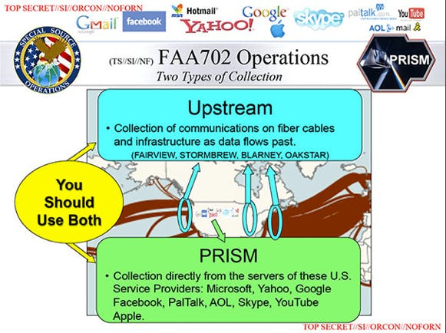

https://www.dailydot.com/debug/nsa-spy-prgrams-prism-fairview-blarney/

Slide 10
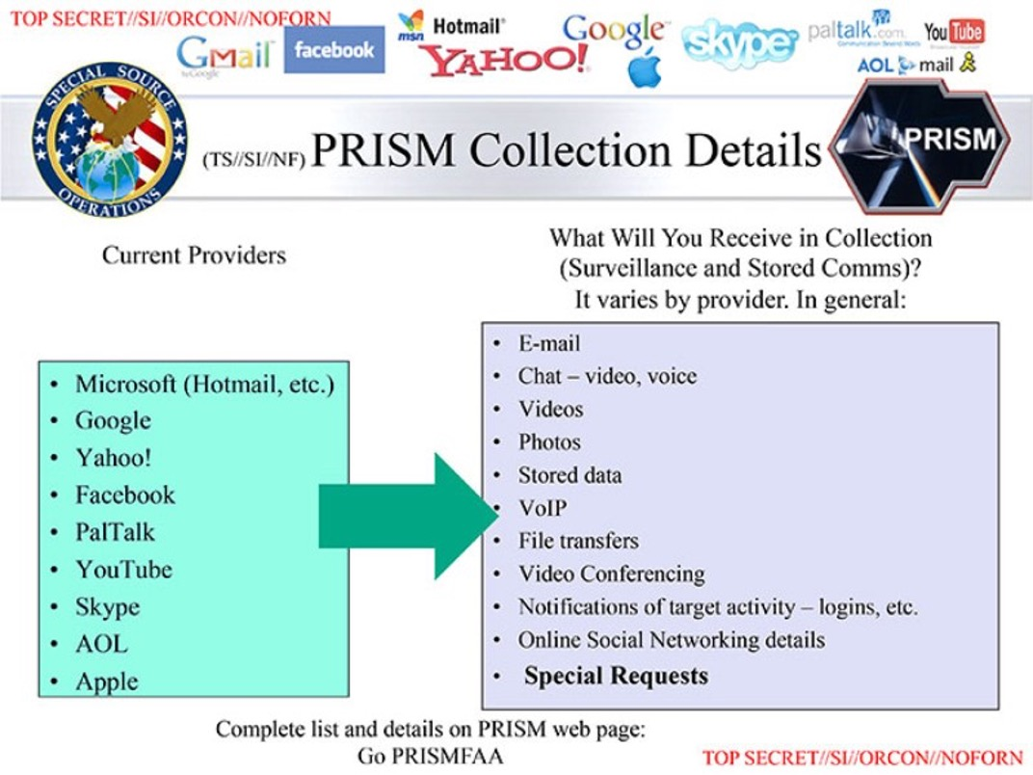
https://www.dailydot.com/debug/nsa-spy-prgrams-prism-fairview-blarney/

Slide 11
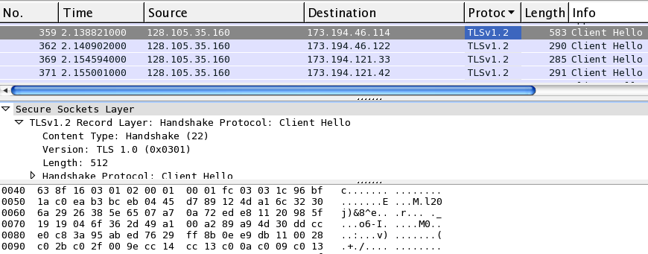
Types of Packet Inspection
IP datagram
IP header
TCP header
Application header
user data
Internet service providers need only look at IP headers to perform routing
Deep packet inspection (DPI) analyzes application headers and data
Shallow packet inspection investigates lower level headers such as TCP/UDP

Slide 12
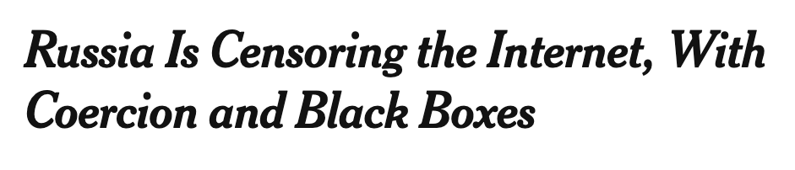
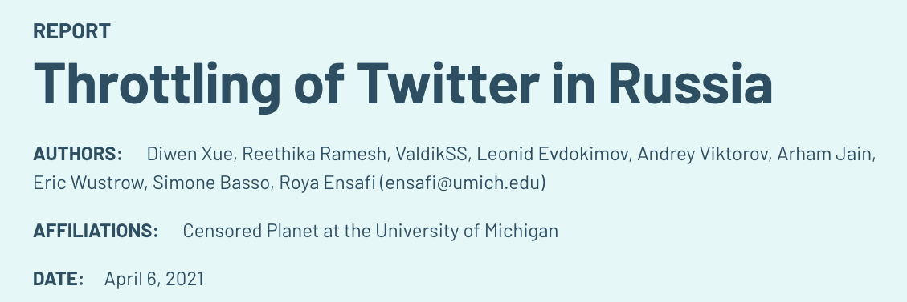

New York Times, October 2021
the software — known as “deep packet inspection” — filters through data traveling across an internet network, slowing down websites or removing whatever it has been programmed to block

Slide 13

Preventing Interception
What does this protect?
What does this leak?
End-to-end encryption
TLS/HTTPS for communicating with servers
What about phone-to-phone?
Interception gear
Other major backbone
AT&T network

Slide 14
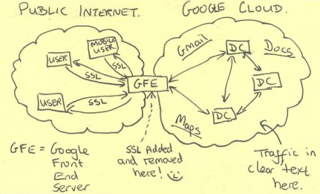
End-run Around HTTPS
HTTPS terminates at the edge of Google networks
Before 2013, no encryption on internal communications between data centers
Over privately leased lines
Actual NSA material (via Snowden)

Slide 15
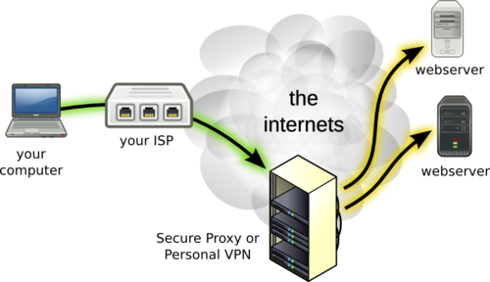
VPN

Slide 17



Signal Protocol
Developed by Whisper Systems
Open-source implementation
Used by Signal, Whatsapp, “Secret Conversations” in Facebook Messenger
End-to-end encryption: third parties and providers do not have access to messages and calls
Forward secrecy: encryption keys cannot be used to go back in time to decrypt previously transmitted messages… nor to decrypt future messages
Moxie Marlinspike

Slide 18
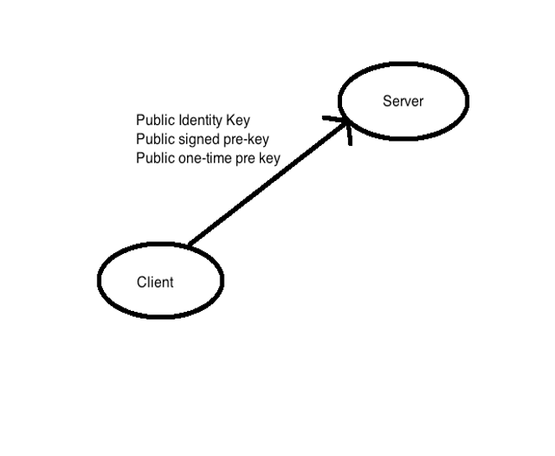
Client Registration
Registering:
Client gives to Signal server a “bundle” of one-time public keys (+ some other stuff)

Slide 19
Client Registration: Details
Client signs her public pre-key:
SSPK = {SPK} signed with IK_{priv}
Sends to server her pre-key bundle:
{ IK_{pub} || SPK_{pub} || SSPK || OPK₁ || OPK₂ || . . . }
ephemeral one-time pre-key public keys

Slide 20
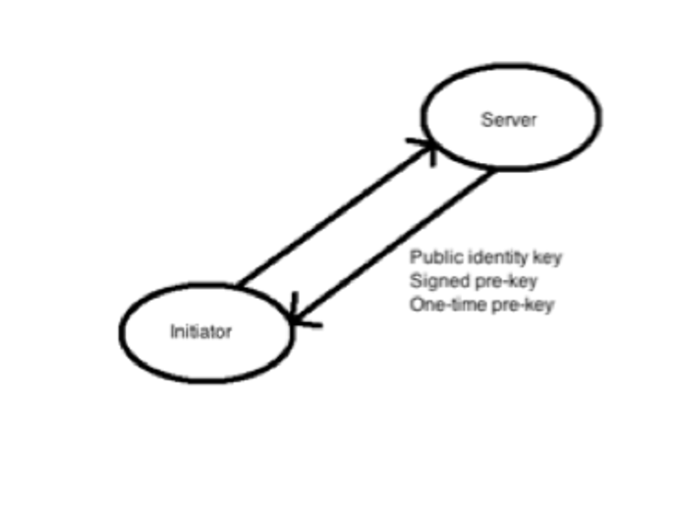
Session Setup / Starting a Conversation
Starting a conversation:
Initiator obtains one of the recipient’s one-time keys,
uses it to derive a set of fresh keys just for this session

Slide 21
Session Setup: Details
Sender obtains recipient’s pre-key bundle
{ IK_{pub,recip} || SPK_{pub,recip} || SSPK || OPK_{recip,i}}
Verifies recipient’s signature on SSPK
Generates new ephemeral key pair EK_{{pub,priv},send}
Computes master secret
ms = ECDH(IK_{priv,send}, SPK_{pub,recip}) || ECDH(EK_{priv,send}, IK_{pub,recip}) ||
ECDH(EK_{priv,init}, SPK_{pub,recip}) || ECDH(EK_{priv,send}, OPK_{recip,i})
Deletes EK_{priv,send} and all intermediate values
one of the recipient’s ephemeral pre-keys

Slide 22
Session Keys
Root key: 32-byte value used to generate chain keys
Chain key: 32-byte value used to generate message keys
Message key: 80-byte key used to encrypt messages
32-byte key for AES-256 encryption
32-byte key for HMAC-SHA256 cryptographic checksum
16-byte initialization vector

Slide 23
Key Generation
s is salt (0 if omitted); x is key material
key k = HMAC_SHA256(s, x)
info is string of characters like “WhisperGroup”
T(0) = “” … T(i) = HMAC_SHA256(k, T(i–1) || info || i)
HDKF(s, x) = T(1) || T(2) || … L octets

Slide 24
Sending Messages
Sender creates message key k_{m} = HMAC_SHA256(k_{c,1}, 1)
Encrypts message using AEAD (authenticated encryption) scheme with AES-256 in CBC mode for encryption and HMAC_SHA256 for authentication, producing ciphertext C
{ IK_{pub,sender} || EK_{pub,sender} || pre-key indicator || C }
new ephemeral key
which of recipient’s one-time
ephemeral public keys was used

Slide 25
Receiving Messages
Recipient computes master secret analogously to sender but using the recipient’s private keys and sender’s public key
Computes the root and chain keys
Deletes ephemeral key pair OPK_{i} used for this exchange
Can now exchange messages…

Slide 26
Updating Message Keys
Each message uses its own key
Sending messages one after another:
create a fresh key for next message using key-based hash derivation
Upon receiving a reply:
create a fresh secret using Diffie-Hellman protocol, use it to derive a fresh key
Compromise of a key for a single message does not reveal keys for previous or future messages

Slide 27
Updating Message Keys: Double Ratchet
For each message sent before receiving a reply, use a hash ratchet to update the message key:
k_{m,i+1} = HMAC_SHA256(k_{c,i}, 1)
k_{c,i+1} = HMAC_SHA256(k_{c,i}, 2)
After receiving a reply, use Diffie-Hellman to generate fresh chain and root keys:
x = HKDF(k_{r}, ECDH(EK_{pub,recip}, EK_{priv,send}))
First 32 octets are the new chain key, next 32 octets new root key
from the received message
private key associated with EK_{pub,send} appearing in the message to which this was a reply

Slide 28
Properties of the Signal Protocol
Confidentiality
Authentication
Participant consistency
Destination validation
Forward secrecy
Post-compromise security (aka future secrecy)
Causality preservation
Message unlinkability
Message repudiation
Participation repudiation
Asynchronicity

Slide 29
What Does the Signal Service Know?
Service knows who is talking to whom
Signal’s privacy policy says that they do not keep identities longer than needed to transmit each message
Only keep the last time user connected to server
What else?

Slide 30
“Crypto Wars”
Manhattan DA report on smartphone unlocking; Apple-FBI conflict
“Going dark” debate
Law enforcement and national-security authorities argue that encryption is preventing criminals and terrorists from being caught
Long history of attempts to build backdoors into secure systems
1990s: export controls on cryptography, Clipper chip
Consensus among security experts: mandated backdoors fundamentally weaken security

Slide 31

Cryptographic Backdoors
Backdoor in NIST’s Dual EC pseudorandom number generator (PRNG)
Brief summary: TLS ClientHello random nonce is a public-key encryption of values sufficient to derive session key
Unauthorized code in Juniper’s NetScreen VPN
Authentication bypass for remote admin access

Slide 32
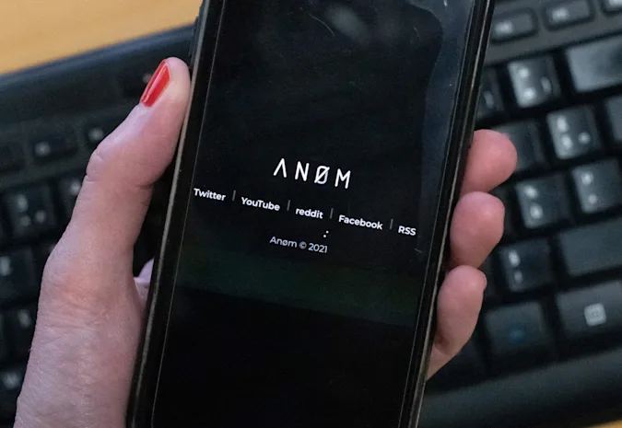
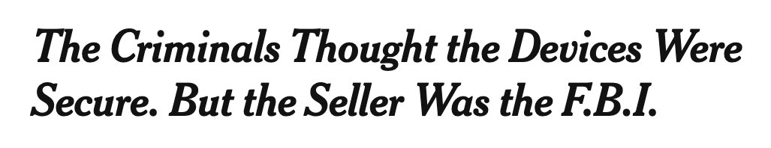
Anom devices were cellphones that had been stripped of all normal functions. Their only working app was disguised as the calculator function: After entering a code, users could send messages and photos with end-to-end encryption
…
Over three years, more than 12,000 Anom devices were sold to over 300 criminal syndicates operating in more than 100 countries. The devices cost varied by location but were generally sold, court papers say, on six-month subscriptions available for $1,700 in the United States.
Pixel 4a with a modified OS
the entire network was actually a sophisticated sting run by the F.B.I., in coordination with the Australian police… arrested at least 800 people in more than a dozen countries
https://www.nytimes.com/2021/06/08/world/australia/operation-trojan-horse-anom.html
https://www.engadget.com/fbi-anom-phone-arcaneos-180523267.html

Slide 33



A technical capability notice could be used to compel the supplier of system software for a smartphone or PC (for instance, Google, Apple, Microsoft, a smartphone hardware manufacturer, or even an Australian telecommunications company that distributes custom firmware for the phones it sells) to hide spyware in an update targeted at a specific smartphone or computer user who is the subject of a law enforcement warrant or an ASIO [Australian Security Intelligence Organisation] investigation.
https://www.smh.com.au/national/encryption-for-the-majority-of-us-life-goes-on-20181210-p50l8r.html

Slide 34



Signal Responds
By design, Signal does not have a record of your contacts, social graph, conversation list, location, user avatar, user profile name, group memberships, group titles, or group avatars. The end-to-end encrypted contents of every message and voice/video call are protected by keys that are entirely inaccessible to us. In most cases now we don’t even have access to who is messaging whom.
Everything we do is open source and anyone is free to verify or examine the code for each release. Reproducible builds and other readily accessible binary comparisons make it possible to ensure the code we distribute is what is actually running on user’s devices. People often use Signal to share secrets with their friends, but we can’t hide secrets in our software.
https://signal.org/blog/setback-in-the-outback/

Slide 35

How to Find Offensive Content?
Interception gear
Other major backbone
AT&T network
Must scan for it on user’s devices
Child sexual abuse material (CSAM)
Terrorist imagery and propaganda

Slide 36
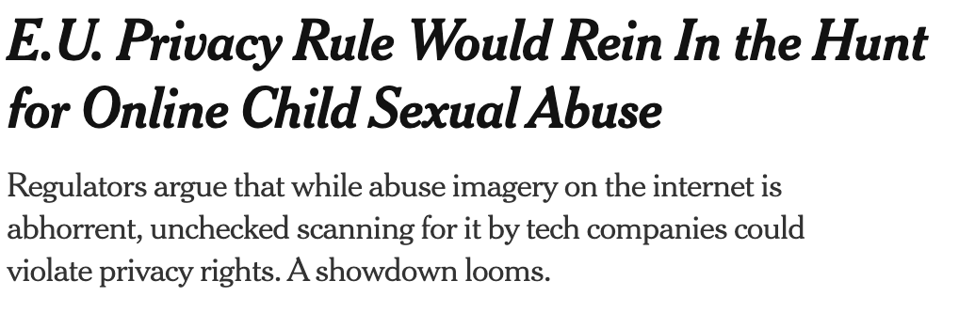
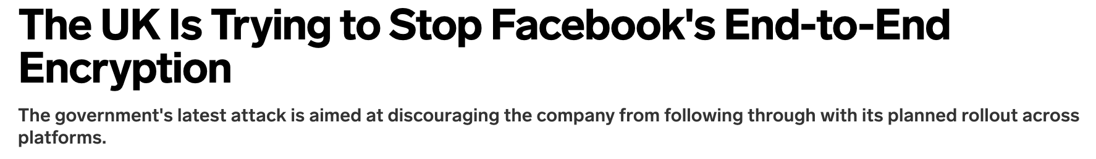
Home Office spokesperson wrote that “end-to-end encryption poses an unacceptable risk to user safety and society. It would prevent any access to messaging content and severely erode tech companies’ ability to tackle the most serious illegal content on their own platforms, including child abuse and terrorism.”
https://www.nytimes.com/2020/12/04/technology/european-union-child-sexual-abuse.html
https://www.wired.com/story/uk-trying-to-stop-facebook-end-to-end-encryption/

Slide 37
Client-Side Scanning Issues
Much more about this in CS 5436 / INFO 5303
Mandatory or voluntary? Legal basis?
Does government-mandated content scanning constitute a “search” under the Fourth Amendment? Do users have legitimate expectation of privacy? Fifth Amendment issues?
What is the authoritative source for identifying offensive and prohibited content?
Typically based on hash matching
False positives and negatives of automated matching algorithms?
Who is notified if content found? How?
https://www.lawfareblog.com/law-and-policy-client-side-scanning

Slide 38

GIFCT
Database of hashes of images and videos with “violent terrorist imagery and propaganda”
Established by Facebook, Microsoft, Twitter, YouTube
Multiple members can submit content, even more have access
Advisory committee with government representatives
Facilitates fast content removal

Slide 39
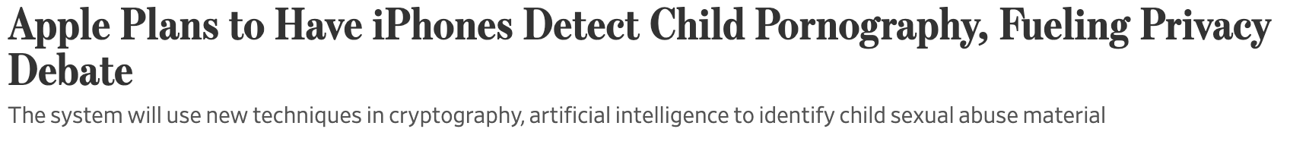
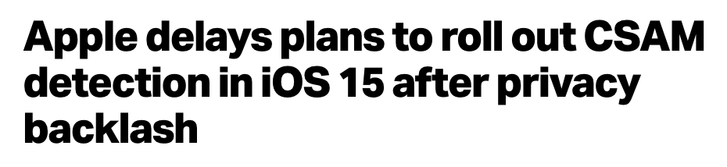
Will match photos uploaded to iCloud against the database of hashes of illegal images from NCMEC (National Center for Missing & Exploited Children). Next generation of Apple’s phone and laptop software would come with the NCMEC hash database pre-installed.
“Based on feedback from customers, advocacy groups, researchers and others, we have decided to take additional time over the coming months to collect input and make improvements before releasing these critically important child safety features.”
https://techcrunch.com/2021/09/03/apple-csam-detection-delayed/

Slide 40
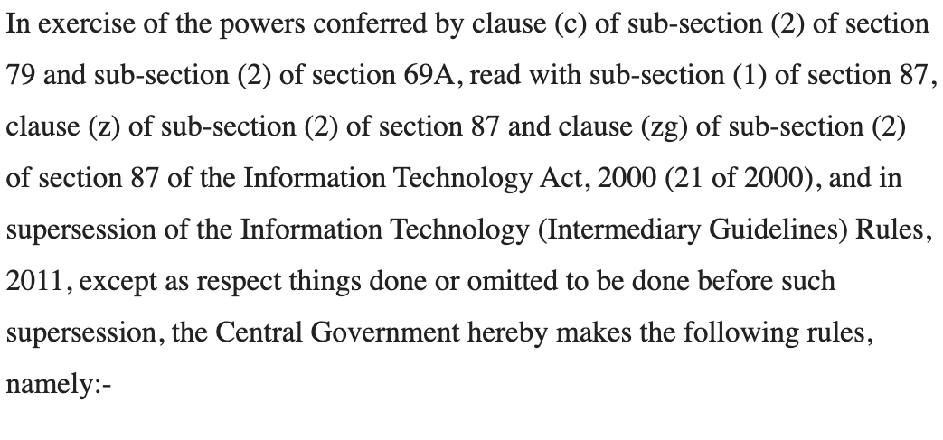
New Rules in India (Feb 2021)

Slide 41

FB, WhatsApp, Twitter Must…
… take down material undermining national security, public order, “decency or morality”
No court approval needed, no clear way to challenge
… identify the first originator of messages
Effectively requires WhatsApp to archive what each user shares
… appoint executives for 24x7 response to takedown requests, must reside in India
Government threatens to jail FB, WhatsApp, Twitter employees for non-compliance
Does end-to-end encryption help in this case?
https://www.wsj.com/articles/india-threatens-jail-for-facebook-whatsapp-and-twitter-employees-11614964542

